Slide 1

Domains and URLs

Slide 2
Domain Name System (DNS)
System for naming resources on a network
Human friendly due to readability
Used on TCP/IP networks – it is part of the TCP/IP protocol
Names created of this system are unique and consists of different levels
This system follows a hierarchy
Some are small, some larger and have more IP addresses

Slide 3
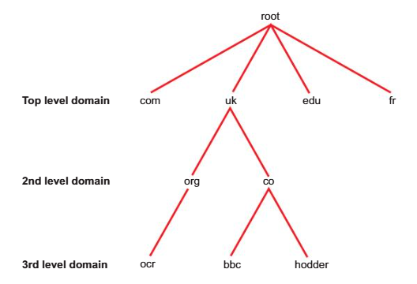
Levels
Top level
2nd level
3rd level
Domains of resource name go from top to bottom, from the right side of the name
Each level is separated by a dot/period (.)
Name further on left is host name

Slide 4
Levels in domain names
One or more equivalent IP addresses
An example of a domain name:
ocr.org.uk
Or another one would be bbc.co.uk
3LD > 2LD > TLD

Slide 5
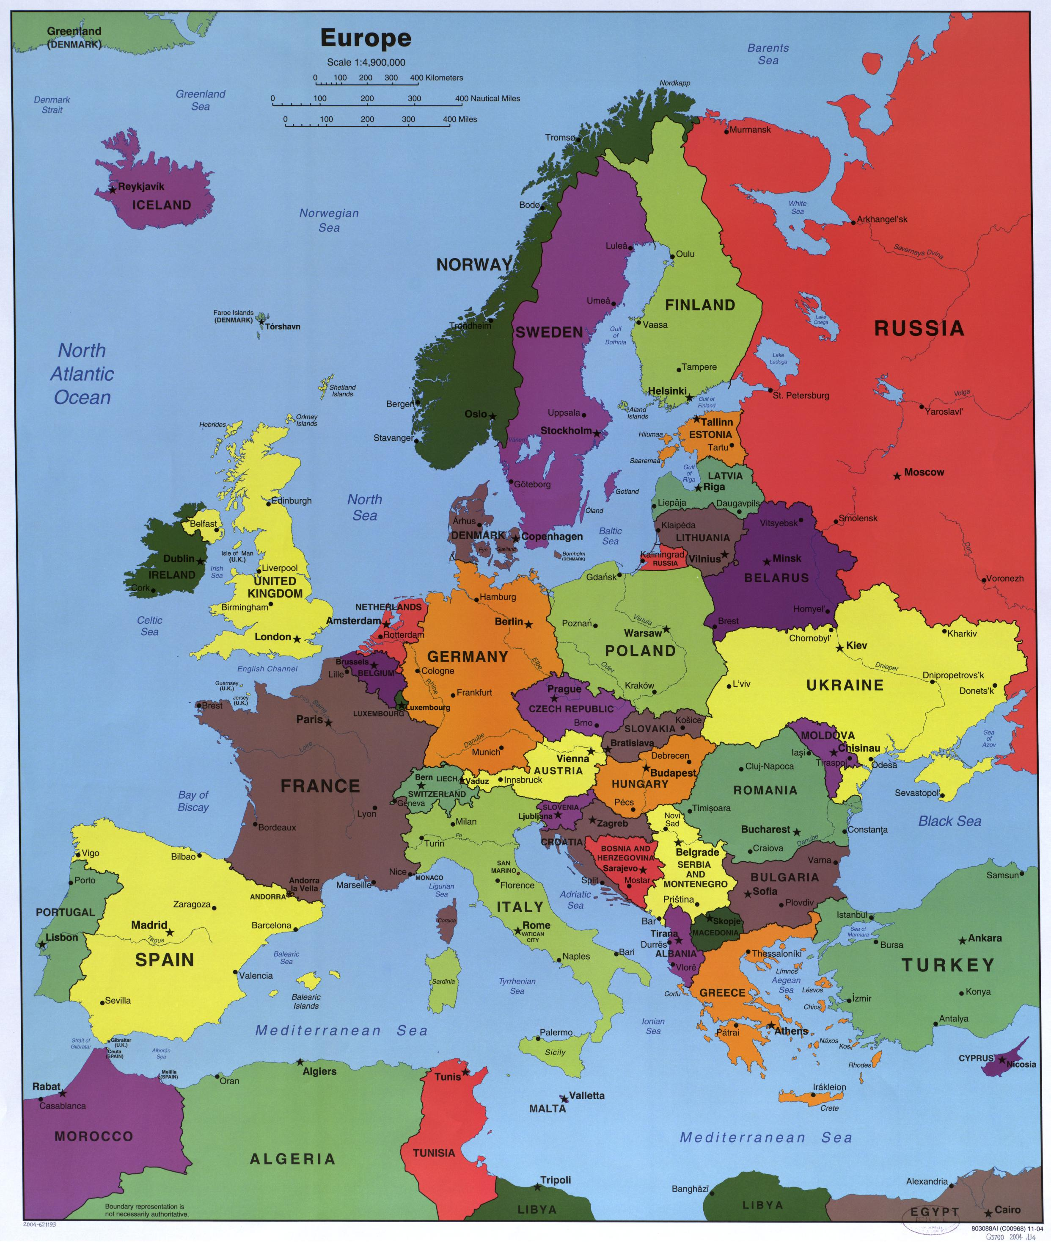
Types of TLDs
Country TLDs:
de
fr
uk
Generic TLDs:
edu
com
org

Slide 6
DNS catalogues
For classifying domain names and IP addresses / categories
Via global directories

Slide 7
Uniform Resource Locator (URL)
Full address of an internet resource, including location, name
May include file type
E.g https://www.domainname.com/folder/subfolder/webpage.html#element
Consists of:
Method
Host
Website
TLD
Location
Resource

Slide 8
Process of accessing a website
URL entered into browser
Request made to DNS
Search for IP related to the domain name in its database
If present, IP is substituted into browser, bringing user to website
Otherwise, forward request to other DNS servers

Slide 9
Fully Qualified Domain Name (FQDN)
Domain name that includes host server name
E.g mail, www, ftp
www. Websitename.co.uk

Slide 10
Internet Registries
Organisations (global) managed by Internet Corporation for Assigned Names and Numbers (ICANN)
Allocate IP addresses
Maintain track of which address(es) a domain name is related to
Have worldwide databases for domain names issued to people
Includes the people’s details

Slide 11
Internet Registries
African Network Information Centre (AFRINIC)
Ebene, Mauritius
American Registry for Internet Numbers (ARIN)
Chantilly, VA, United States of America
Asia Pacific Network Information Centre (APNIC)
Brisbane, Australia
Latin America and Caribbean Network Information Centre (LACNIC)
Montevideo, Uruguay
Reseaux Europeens Network Coordination Centre (RIPE NCC)
Amsterdam, Netherlands

Slide 12
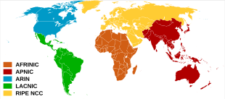
Internet Registries
Service locations
AFRINIC - Africa
APNIC - East, South, Southeast Asia, Oceania
ARIN – Antarctica, US, Canada, Caribbean countries and territories
LACNIC – Latin America, Caribbean countries and territories
RIPE NCC – Central, west Asia, Europe, Russia

Slide 13
Internet Registrars
Holds existing website names + details of domain names for these website names currently purchasable
Puts them up for purchase
Must be accredited by their governing registry

Slide 14
IP addresses
Internet Protocol address
Unique – for network devices
Binary numbers in readable form
Function similarly to home mailing addresses
For a domain name, if it is related or linked to an IP, the IP is the address of the website’s resident server
Indicate where data is going
Routers use this address to control where data goes
E.g 87.186.113.134

Slide 15
IPv4 and IPv6
Different versions of IP addresses
IPv4 – 32-bit numbers
IPv6 – 128-bit numbers

